Slide 1
CS 447/647
Logging

Slide 2
Overview
General
Log Locations
systemd Journal
syslog
Kernel and Boot-time logging
Logging at scale

Slide 3
What is logging?
Line of text with properties
Timestamp
Type
Severity
Process Name
PID
Used to glean useful, actionable information
AKA Log Management

Slide 4
tail -n 2 /var/log/syslog
Feb 16 09:36:53 banyan dnsmasq[21819]: using nameserver 134.197.5.1#53 Feb 16 09:36:53 banyan systemd[1]: Started dnsmasq - A lightweight DHCP and caching DNS server.

Slide 5
Log Management
Collecting logs from a variety of sources
Providing a structured interface for analysis
Filtering
Monitoring
Managing the retention
Legal - eDiscovery
UNR has a 90 day policy
syslog - The traditional system for Unix logging
Handles storing and forwarding logs
Does not provide filtering or monitoring
Bypassed by certain applications

Slide 6
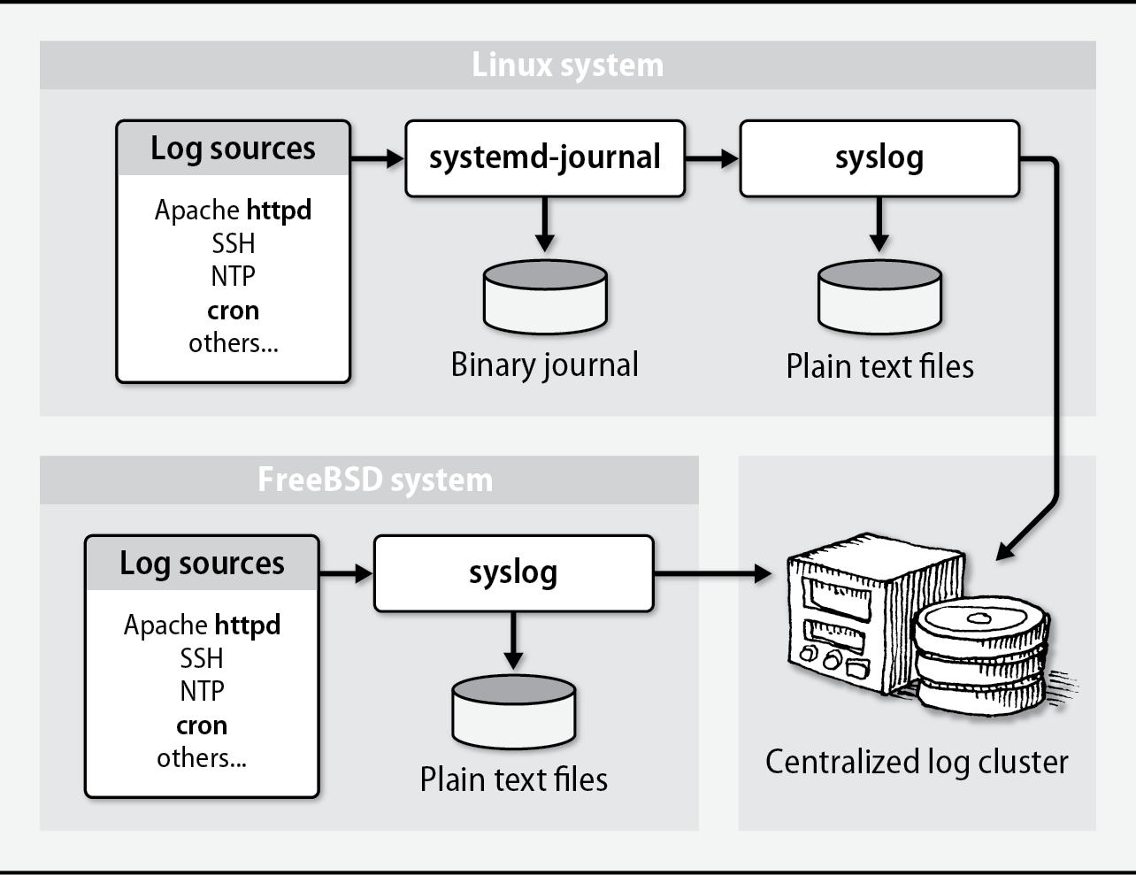

Slide 7
Why?
Regulatory Compliance
PCI DSS - Payment, Visa, MasterCard...
COBIT - IT Governance
ISO 27001
Debugging
Configuration errors
Security

Slide 8
Log Locations
Most logs are in /var/log
Important ones:
auth.log - Authentication & Authorizations
sudo, ssh, PAM
mail - All mail facilities
messages - Main system log
syslog - System log file
Mostly owned by root
httpd - www-data
uwsgi - user-defined
/var/log is often on a separate partition.

Slide 9
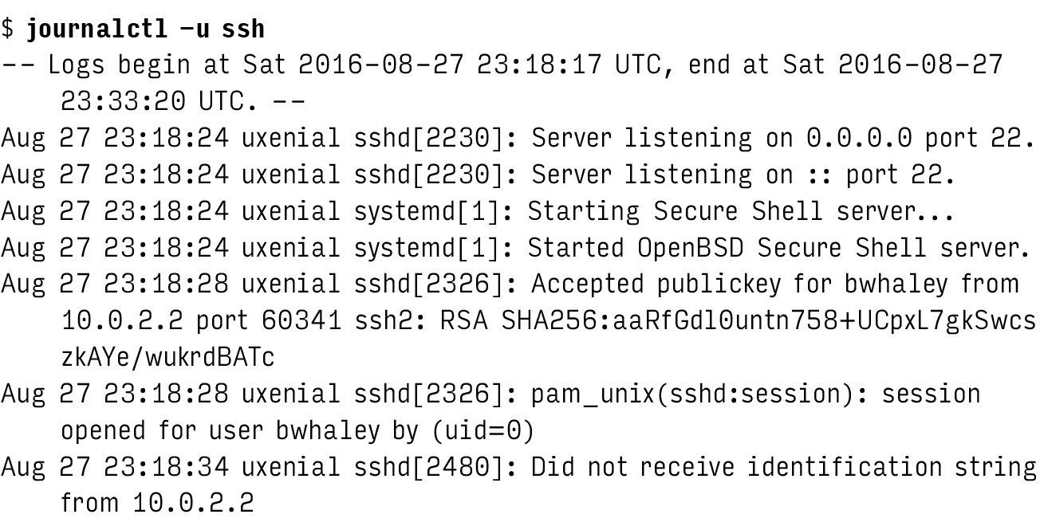
Viewing log files

Slide 10
systemd Journal
System service that collects and stores logging data
Stores log entries in a binary format
Indexed
Collects entries from
/dev/log - socket
/dev/kmsg - kernel
/run/systemd/journal/stdout - collects stdout from services
/run/systemd/journal/socket - API

Slide 11
Configuring journald
/etc/systemd/journald.conf /etc/systemd/journald.conf.d [Journal] #Storage=auto #Compress=yes #Seal=yes #SplitMode=uid #SyncIntervalSec=5m ….
Notes:
Storage - How long the logs will be stored in memory
Seal - used to protect journal files from unnoticed alteration SplitMode - Controls whether to split up journal files per user, either "uid" or "none".
SyncIntervalSec - The timeout before synchronizing journal files to disk.

Slide 12
journalctl filters
journalctl -b 0 -u ssh
journalctl --since=yesterday --until=now
journalctl -n 100 /usr/sbin/sshd

Slide 13
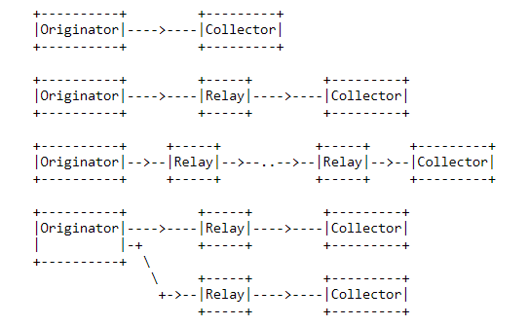
syslog
Logging system and IETF protocol
RFC5424

Slide 14
syslog
Two functions
Elevate developers from having to write logging systems
Administrative control over logging
Logs can be sorted by
Source - Facility
Importance - Severity Level
Centralized logging
Modern version is rsyslog
reliable and extended syslogd

Slide 15
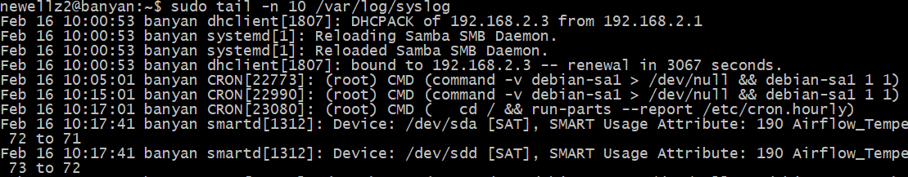
Reading syslog messages
tail -n 20 /var/log/syslog
Fields
Timestamp
Hostname
Process name and PID
Message

Slide 16
rsyslog
Configuration in /etc/rsyslogd.conf
Starts at boot
Uses /dev/log (Unix Domain Socket)
Supports
Files
MySQL
Kafka

Slide 17
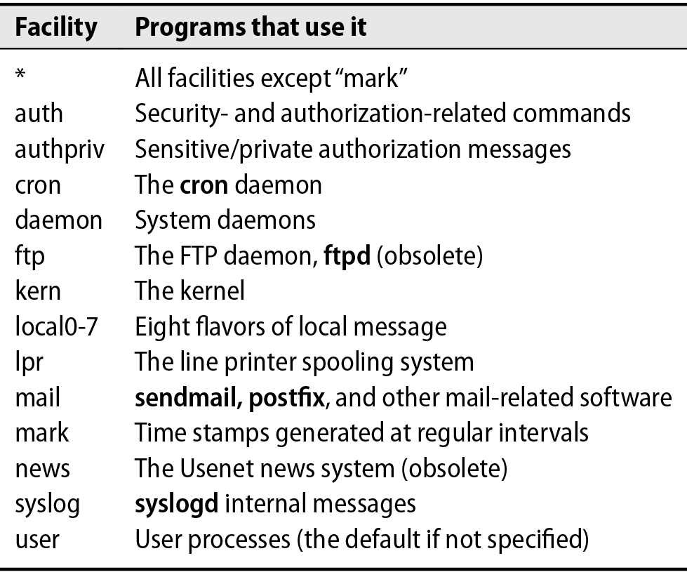

Slide 18
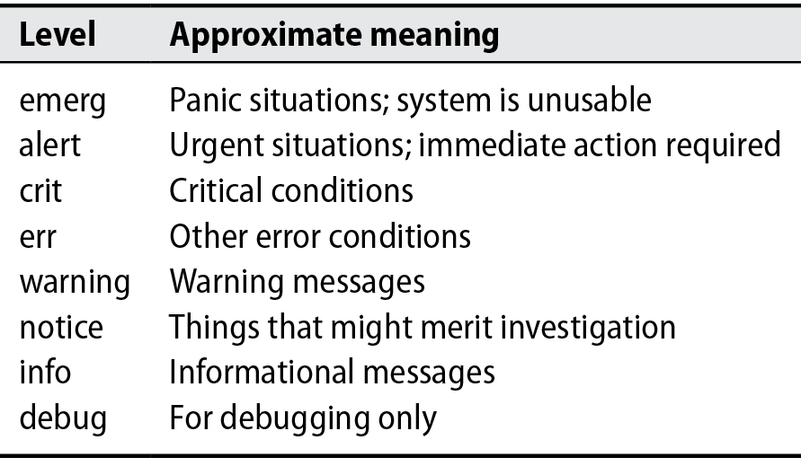

Slide 19
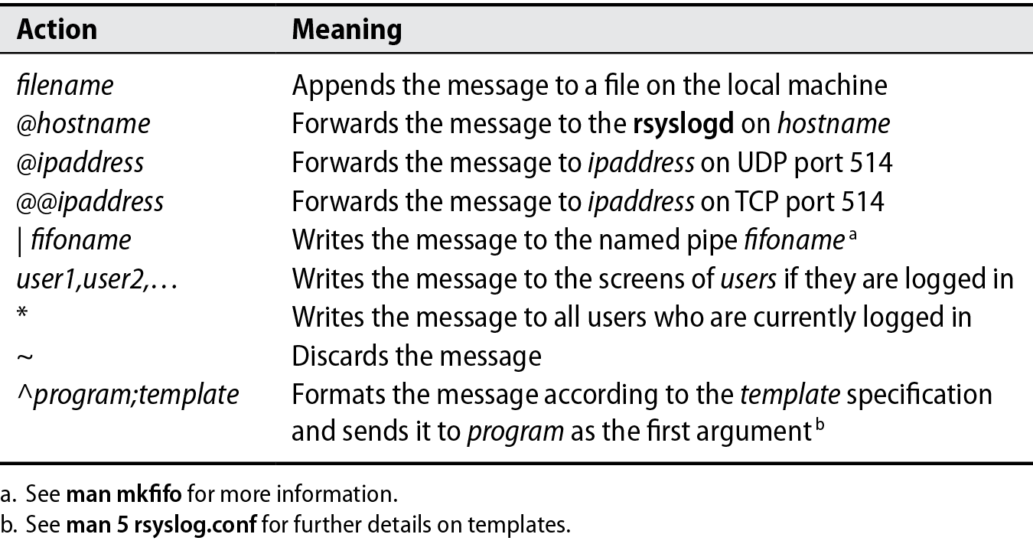

Slide 20
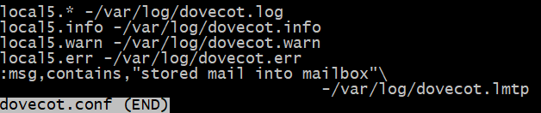

Slide 21
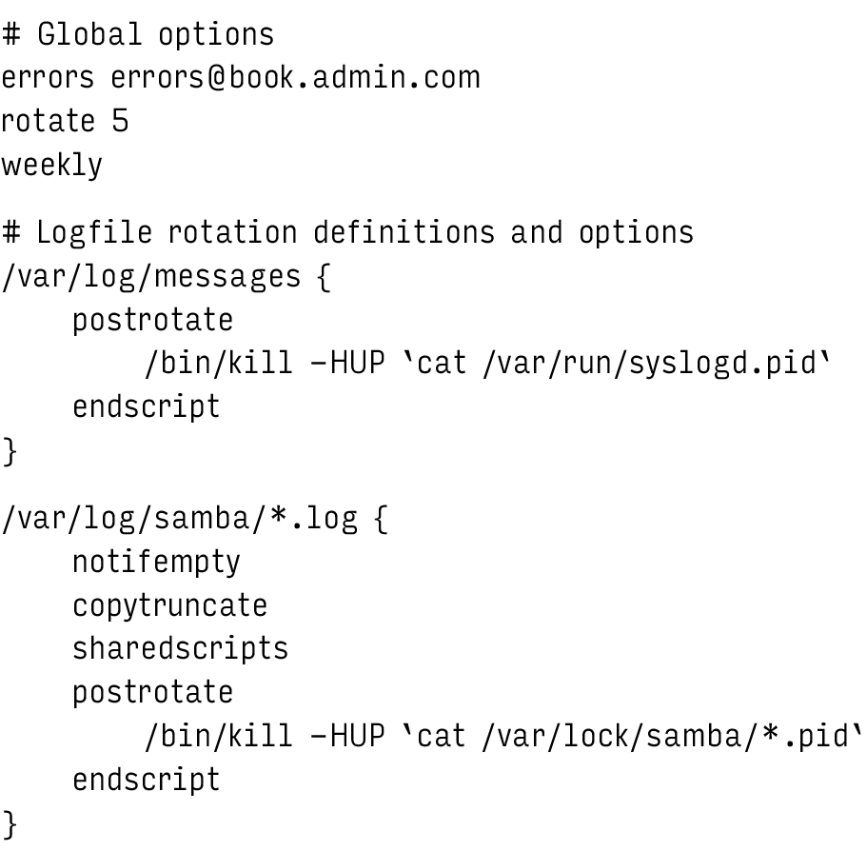
Log rotation

Slide 22
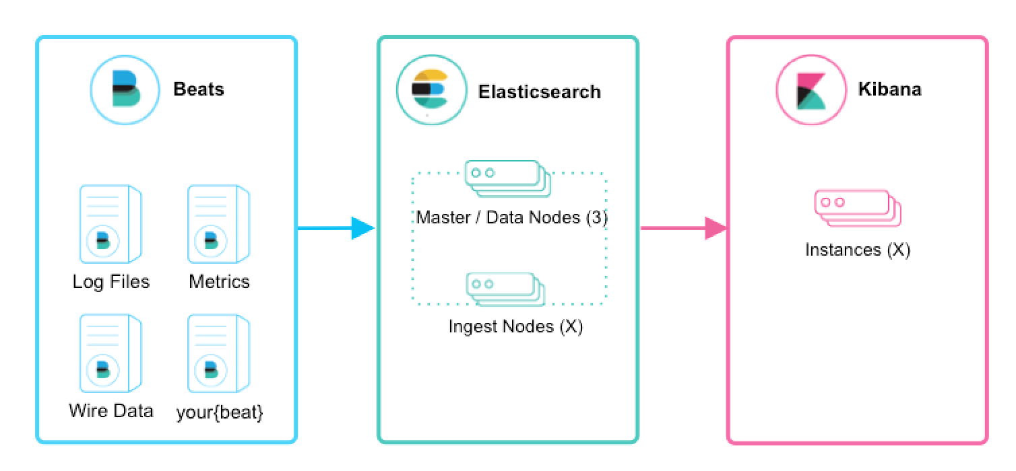
Logging at scale
Elasticsearch, Logstash, Kibana - ELK
Open-source leader

